Slide 1
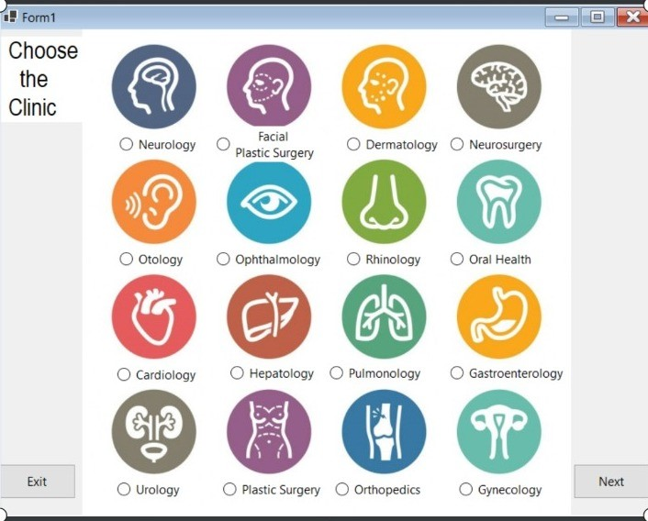
Easy Hospital mode
New way in Hospital management systems

Slide 2
By
محمد فتحي سيد احمد
محمد مدحت محمد علي
محمد عماد حسين عبد الباري
محمد عبد الله محمد علي
مجموعه 3 سكشن 4

Slide 3

Purpose
The software is for the automation medical centre management system.
Save money for patient and medical centres.
The system will be used to get the information from the patient and then storing that data for future usages.

Slide 4

Summary
We develop the Medical center management system for the hospital staff and other department that for record for all the users.
The system functions can be described as follows: Registration: When a patient is admitted, the front-desk staff enters the patients ID Number into the computer. Otherwise, the patient's information such as date of birth, address and telephone number is also entered into computer system.
Patients check out: If a patient checks out, the administrative staff shall delete his ID Number from the system and the just evacuated bed is included in available-beds list.

Slide 5
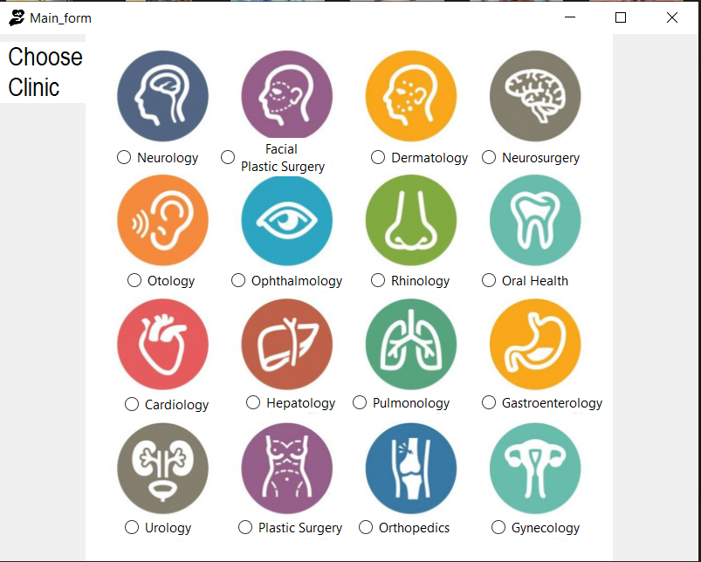
This is the introduction form
Here you will choose the Clinic

Slide 6
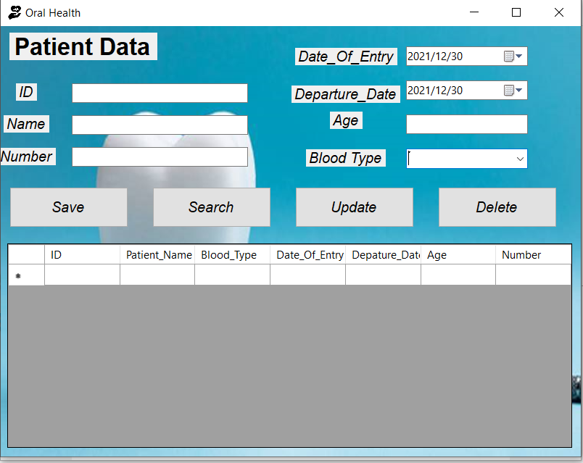
Here you write your ID, name, age, blood type, phone number and Date

Slide 7
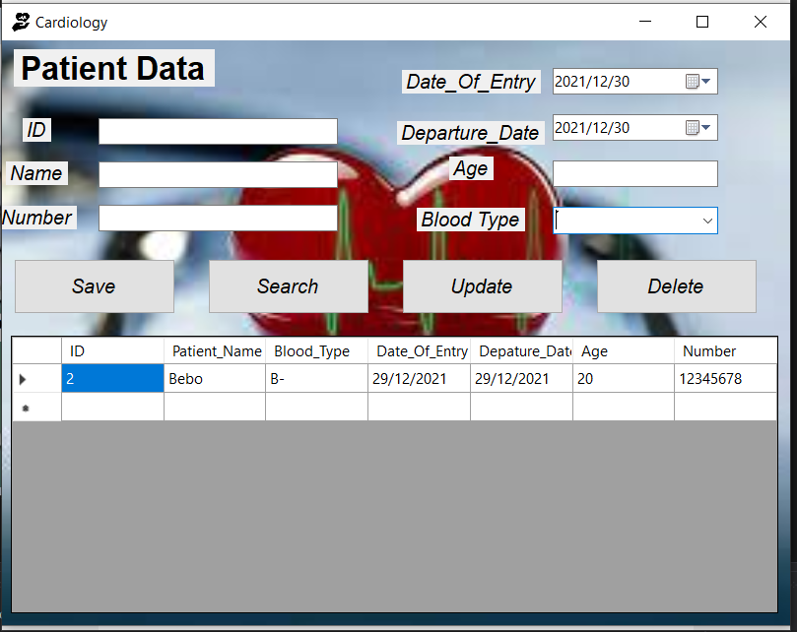
When click Save data will be Saved in SQL Database and data grid view

Slide 8
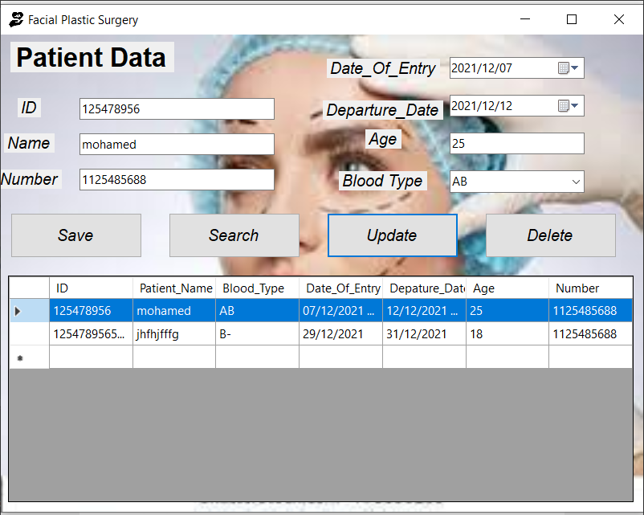
When click update data will be updated in SQL Database and data grid view

Slide 9
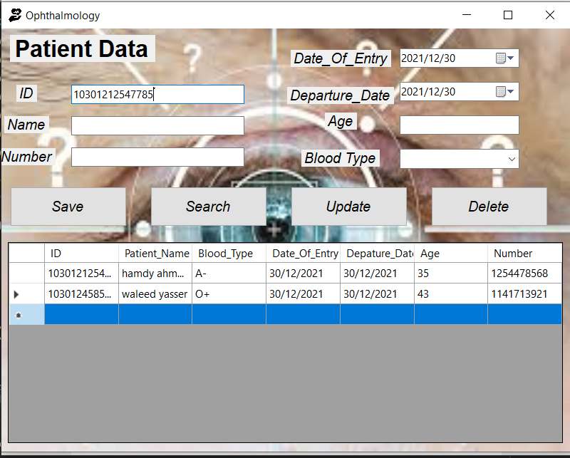
When you want to search about patient you will write patient’s ID and click Search data will be showed in their places

Slide 10
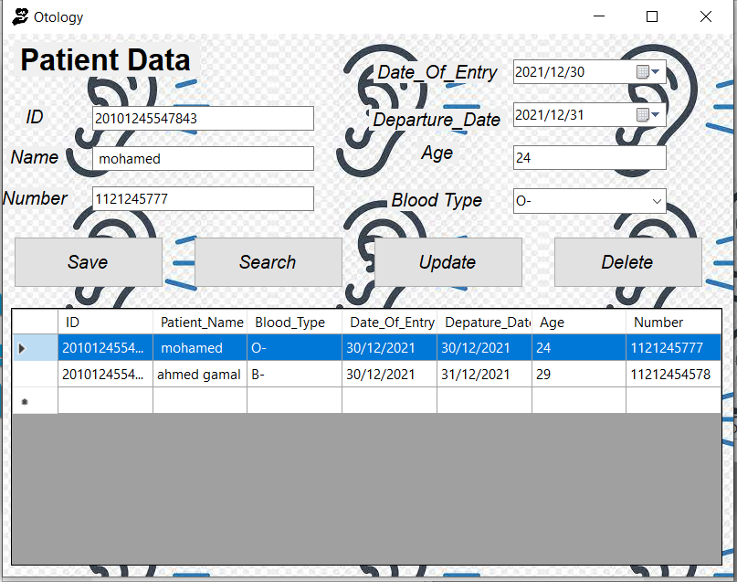
When click Delete data will be Deleted in SQL Database and data grid view

